Slide 1
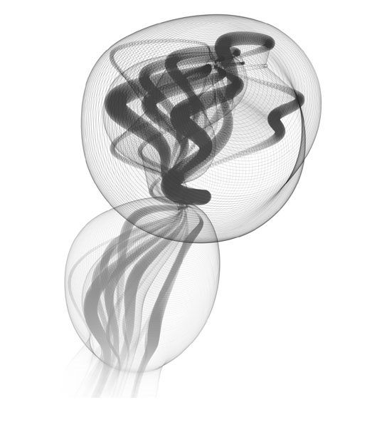
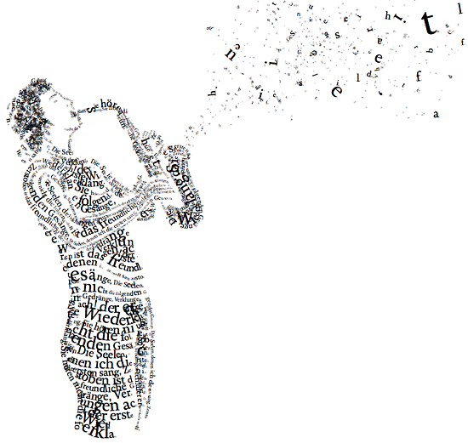
CIS 110 Introduction to Computer Programming
Harry Smith
www.cis110.com

Slide 2
What is Computing?

Slide 3



Computing: internet, e-mail, network…

Slide 4
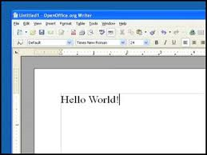
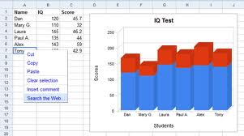
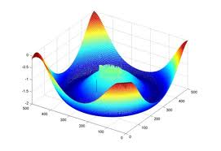
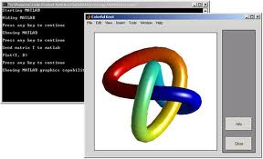
Computing: Productivity…

Slide 5
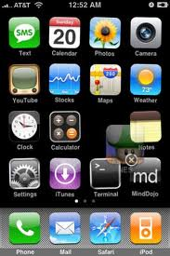




Computing: Entertainment…

Slide 6

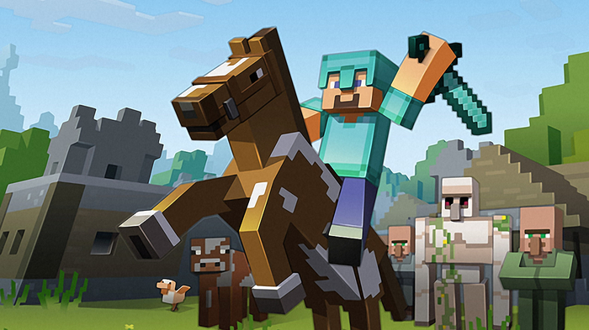


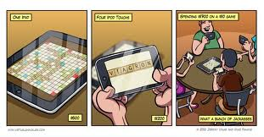
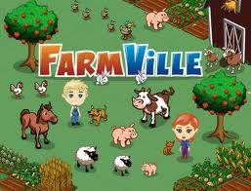
Computing: Entertainment…

Slide 7

“Computer science is no more about computers than astronomy is about telescopes”
- Edsger Dijkstra

Slide 8
Cutting Edge Computer Science

Slide 9
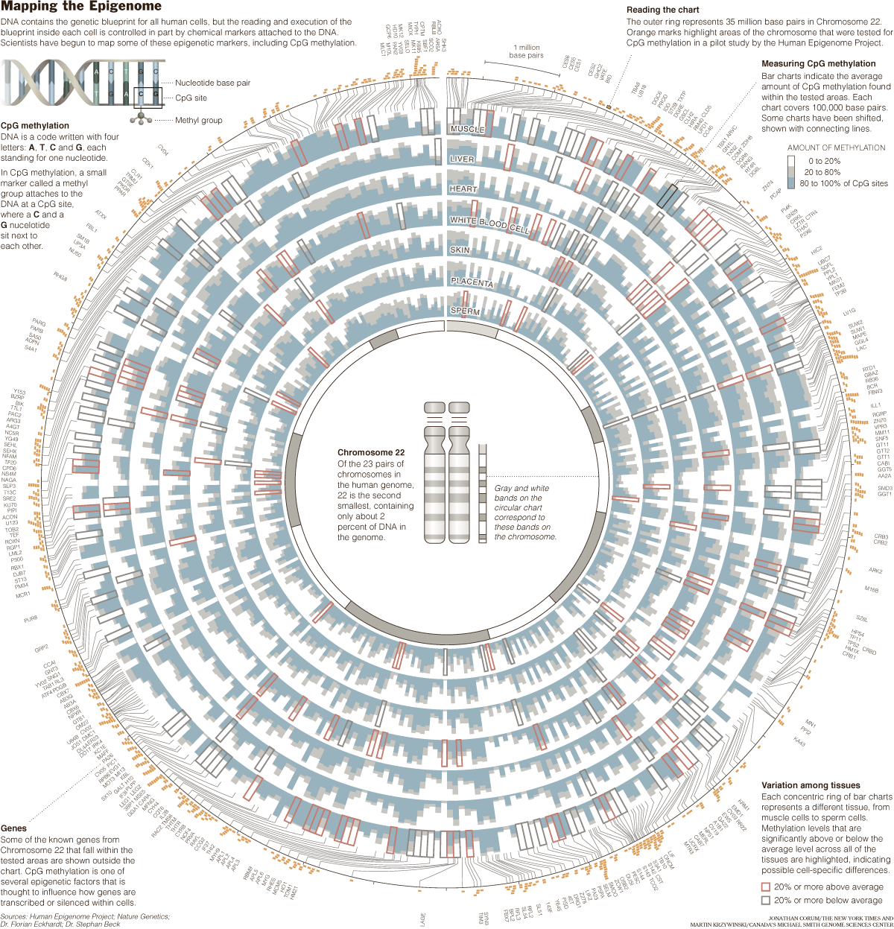

Slide 10
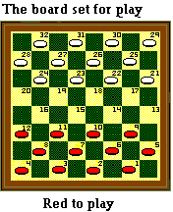

Chinook
Chinook is the World Man-Machine Checkers Champion, developed by researchers at the University of Alberta.
It earned this title by competing in human tournaments, winning the right to play for the (human) world championship, and eventually defeating the best players in the world.
Visit http://www.cs.ualberta.ca/~chinook/ to play a version of Chinook over the Internet.
The developers have fully analyzed the game of checkers and have the complete game tree for it.
Perfect play on both sides results in a tie.
“One Jump Ahead: Challenging Human Supremacy in Checkers” Jonathan Schaeffer, University of Alberta (496 pages, Springer. $34.95, 1998).

Slide 11
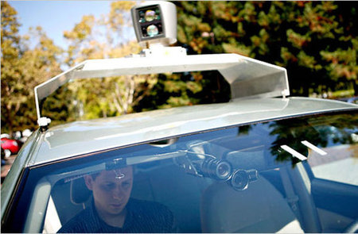
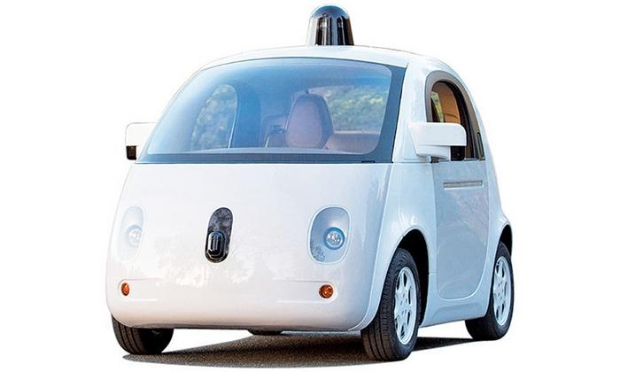
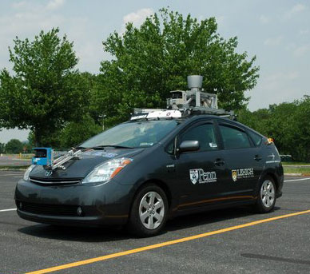
Autonomous Cars
As of 2016
Penn’s Autonomous Car

Slide 12
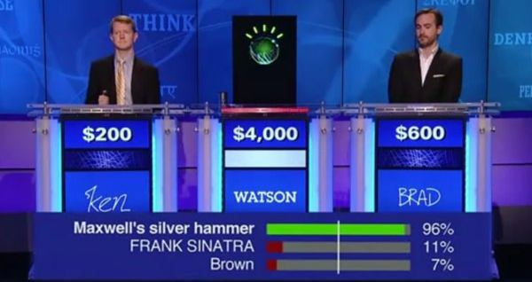
2011 Jeopardy!
In February 2011, IBM Watson bested Brad Rutter (biggest all-time money winner) and Ken Jennings (longest winning streak)
IBM is currently applying Watson’s technology to medical diagnosis and legal research

Slide 13
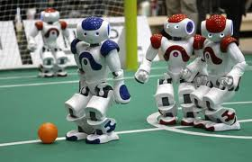
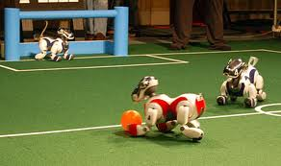
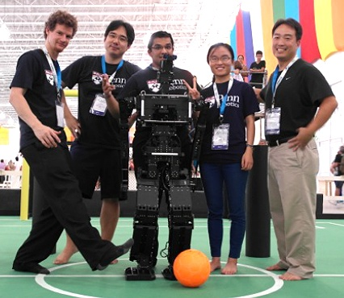
Robot Soccer
Aibo League
UPennalizers
Robot Soccer Team

Slide 14
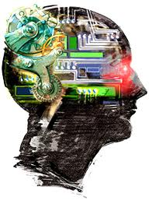
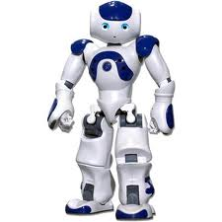
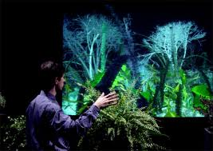

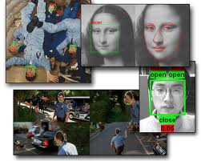
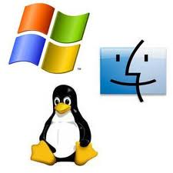
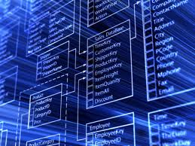



Areas in Computer Science
Artificial
Intelligence
Robotics
Human-Computer
Interaction
Computer
Graphics
Computer
Vision
Operating
Systems
Computer
Networking
Databases
Computer
Security
Ubiquitous
Computing

Slide 15
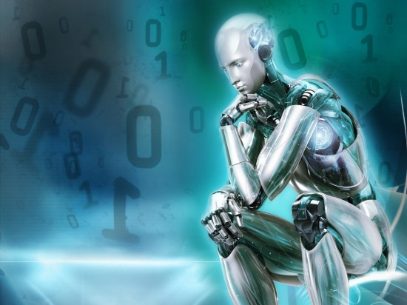
What is Computer Science?
Computer science is the
study of solving problems
using computation
Computers are part of it,
but the emphasis is on the
problem solving aspect
Computer scientists work across disciplines:
Mathematics
Biology (bioinformatics)
Chemistry
Physics
Geology
Geoscience
Archeology
Psychology
Sociology
Cognitive Science
Medicine/Surgery
Engineering
Linguistics
Art
…

Slide 16
Computing is important

Slide 17
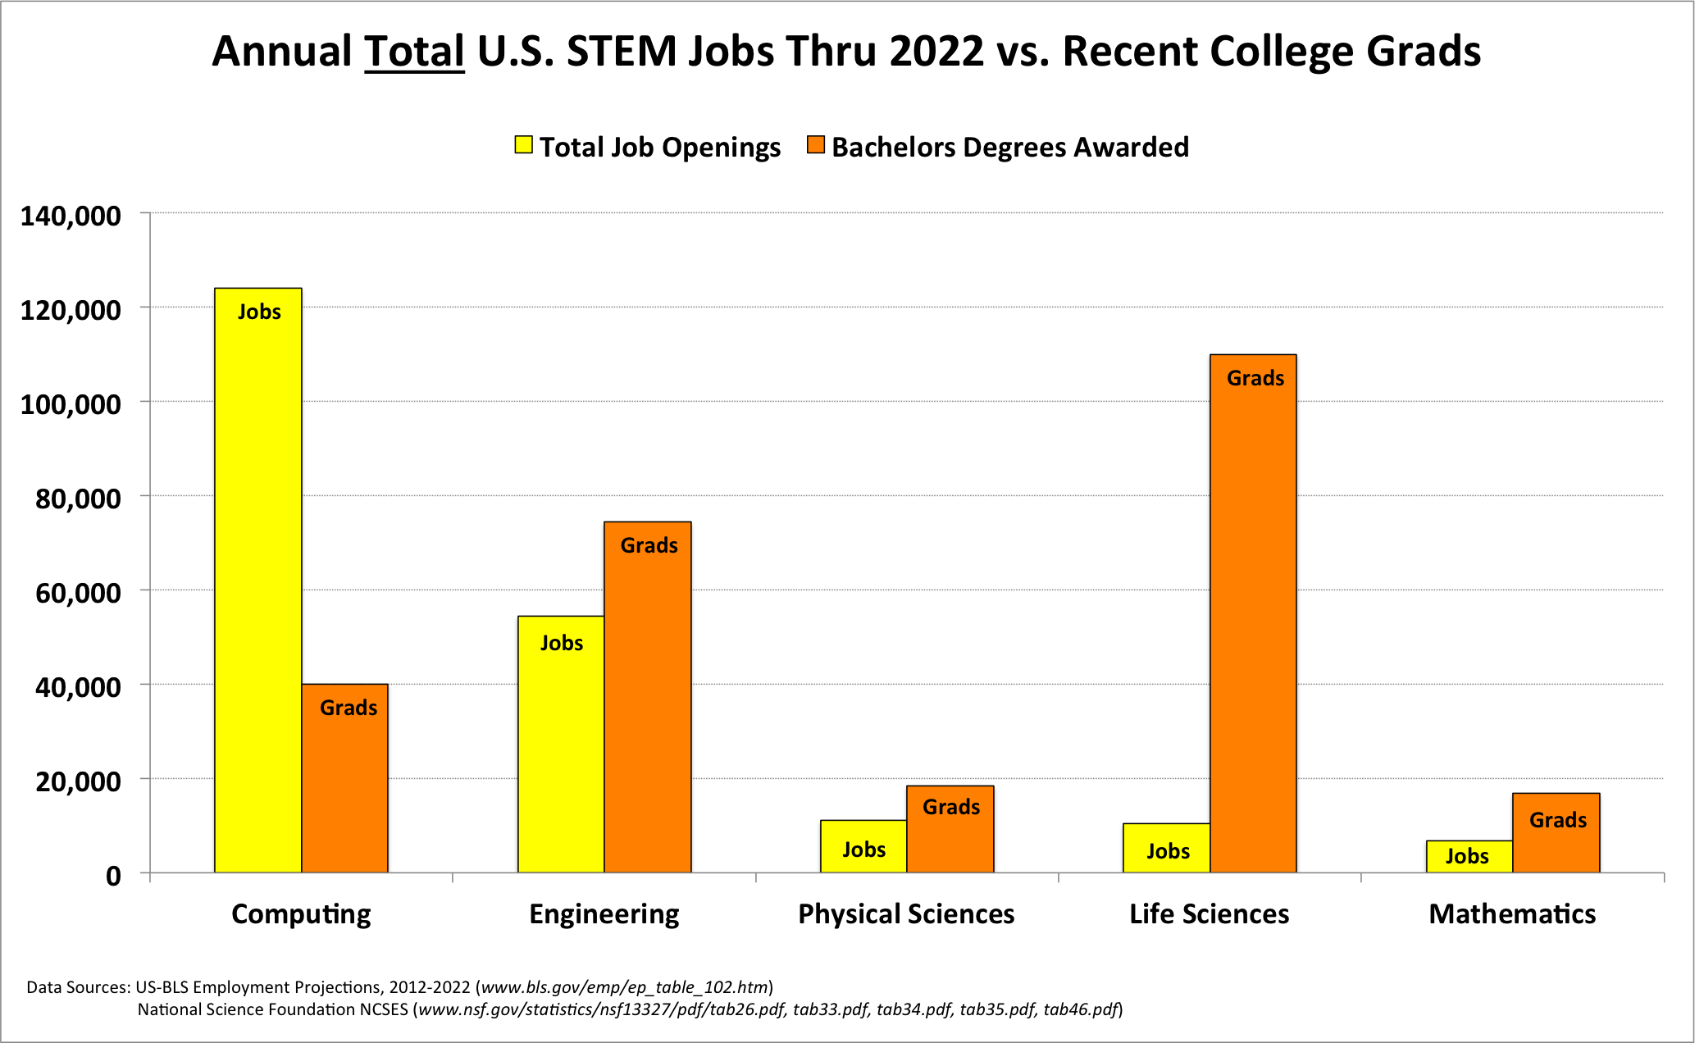

Slide 18
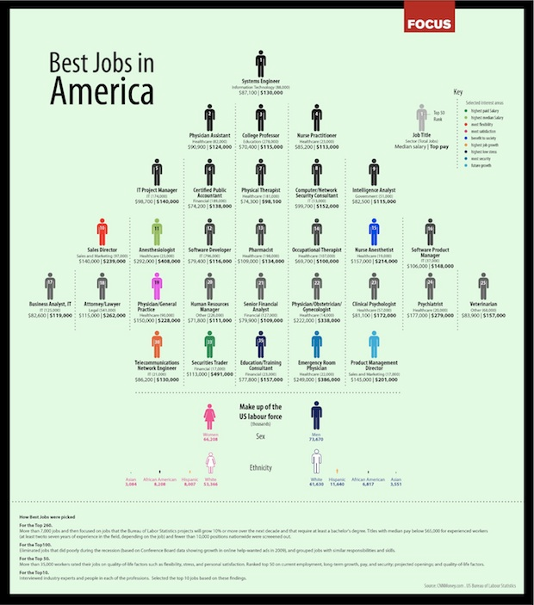
Computing is Consistently Ranked Among the Best Occupations
CS-Related Jobs Highlighted in Red
CNN’s Top 100 Jobs 2010
(Graphic by Focus.com)
#1 | Software Developer | #6 | Statistician
#2 | Dentist | #7 | Pediatrician
#3 | Physician’s Assistant | #8 | Obstetrician and Gynecologist
#4 | Nurse Practitioner | #8 | Oral and Maxillofacial Surgeon
#5 | Orthodontist | #8 | Physician
The 25 Best Jobs of 2017
CS Careers Rank Highly In:
Job satisfaction
Salary
Work/life balance
Growth potential
Employment rate
Work environment

Slide 19
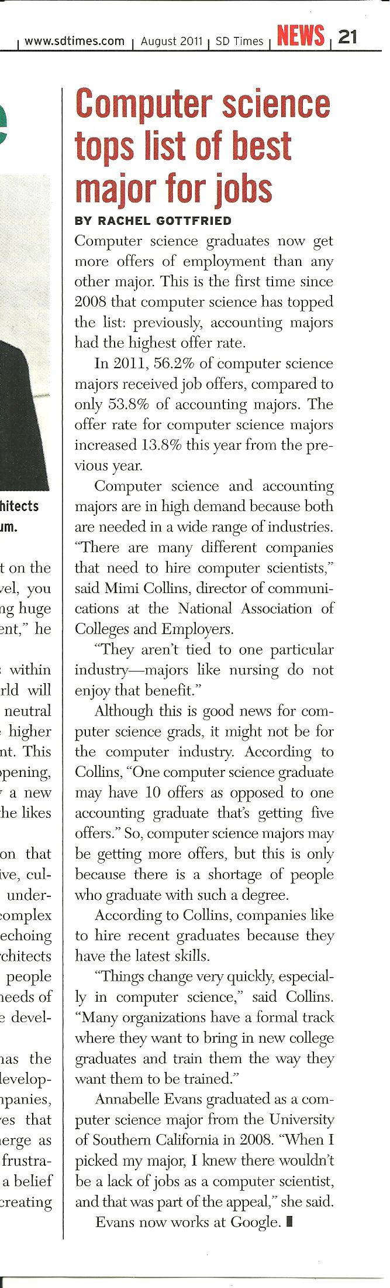
…many different companies … need to hire computer scientists. They aren't tied to one particular industry.

Slide 20
Computing has consequences

Slide 21
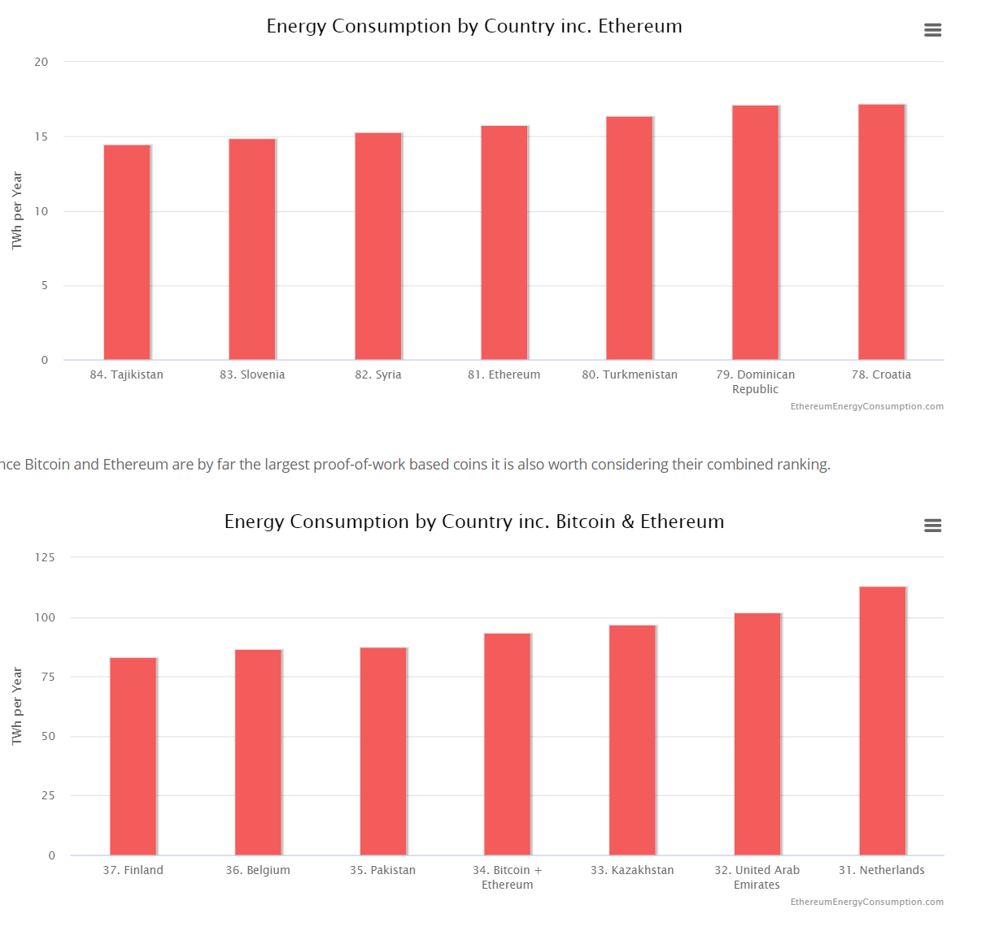
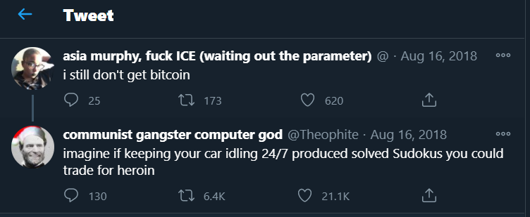

Slide 22
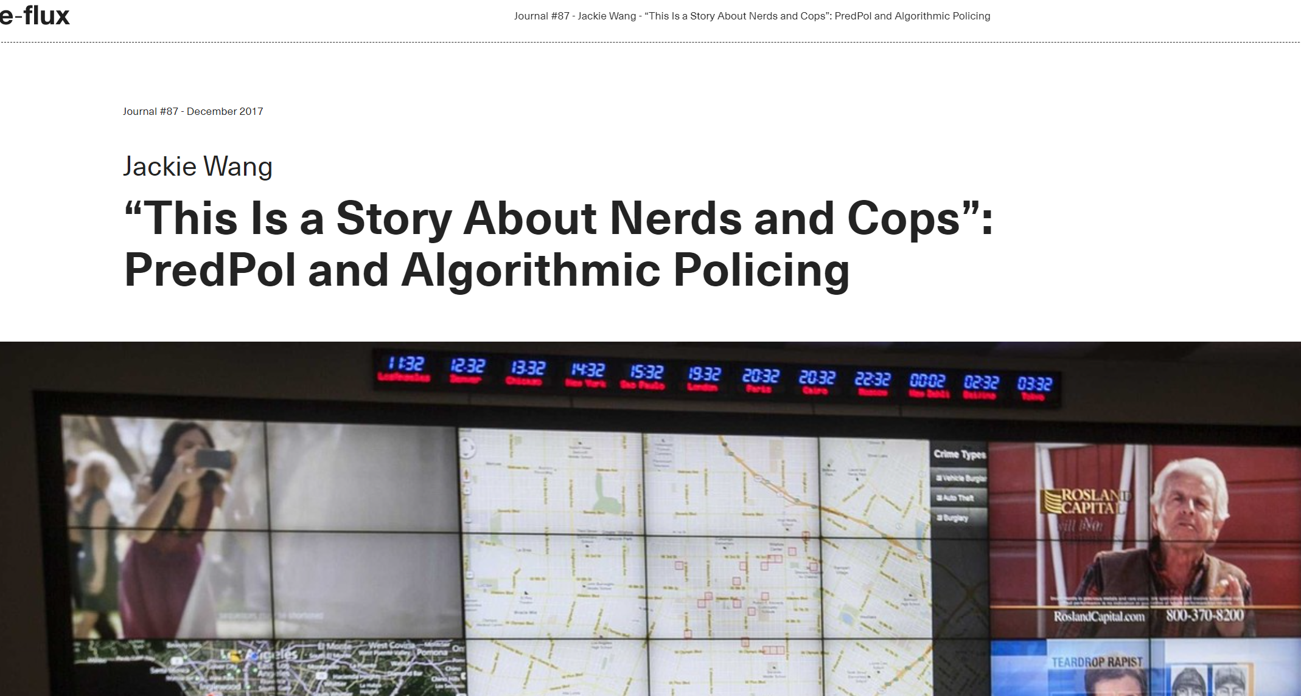

Slide 23
Administrivia

Slide 24
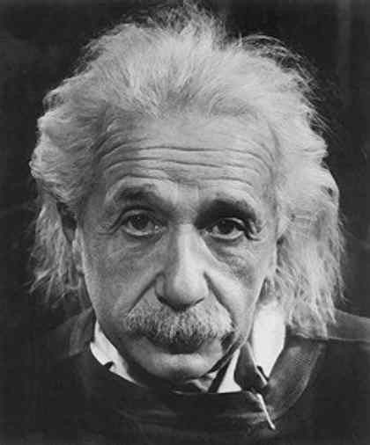
Overview
CIS 110: Introduction to Programming and Computer Science
Goals:
How can we use computers to solve problems?
How can we formulate problems so that we can solve them via computation?
Topics:
Programming in Java
Computer organization and assembly language
Applications to science, engineering, and art
“ Computers are incredibly fast, accurate, and stupid; humans are incredibly slow, inaccurate, and brilliant; together they are powerful beyond imagination. ” − Albert Einstein
Notes:
This course is a broad, but substantive introduction to computer science and programming. (experienced programmers, see COS 217 or COS 226)
Computer science embraces a significant body of knowledge that is: (i) intellectually challenging, (ii) pervasive in modern life, and (iii) critical to modern science and engineering.
We have three primary goals in this course. First, we want to demystify computer systems by unpeeling levels of abstraction down to the simplest physical component, leaving no black boxes. Second, we want to empower you and provide the experience and insight necessary to exploit available technology whenever appropriate. Third, we want to build awareness of the substantial intellectual underpinnings of the field and its broad reach into other sciences.
You need no previous experience to do well here. And while programming will be a big part of what we'll do, it will not be the only thing.
Programming is essential to being able to effectively use computers in any academic discipline.
Architecture refers both to the art of designing computers and to the process of building them.
Theory helps us to understand the limits on what we can accomplish with computers.
-----------------------------

Slide 25
The Basics
Instructor: Harry Smith
Harry’s Regular Office Hours: Thursdays, 10am-12pm on Zoom
sharry@seas.upenn.edu – only for personal or sensitive communication; everything else should be sent through Piazza.
TA Office Hours:
Help with debugging
Office Hours on OHQ.io, Mon-Thurs 11am-1pm & 3pm-9pm
Only use Piazza, office hours, or email to contact your TAs.
Do not send a Slack DM to a TA unless you’ve spoken with them directly about it ahead of time.
Full details: www.cis110.com

Slide 26
Grading
Grade Breakdown:
Homeworks: 64%
Exam 1: 12%
Exam 2: 12%
Check-in Quizzes : 12%
Exam 1: Mar 19th on GradeScope (timing TBD)
Exam 2: Apr 21st on GradeScope (timing TBD)
Notes:
You can check your grades on GradeScope
Notes:
For those few of you concerned about grading, here's how it works.
There is a substantial amount of work in this course and we have high expectations.
it is possible albeit quite difficult to get an F and hard to get an A+.
Everybody can get an A.
Use staff discretion to extract extra information in addition to numbers.

Slide 27
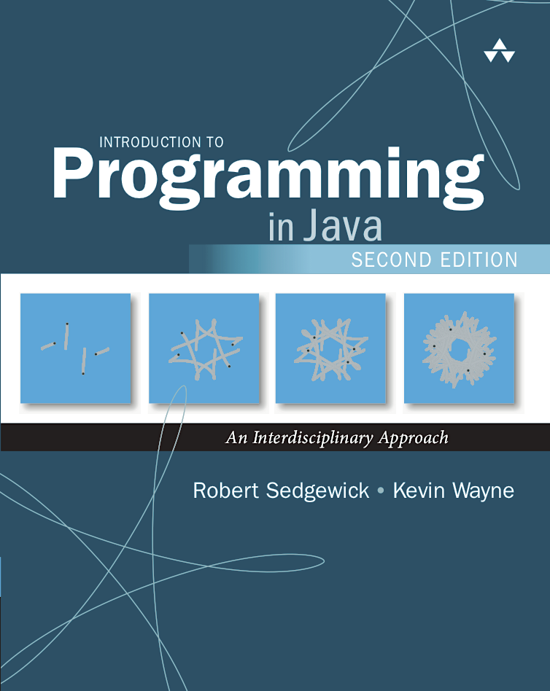
Course Materials
Course Website: www.cis110.com
Programming assignments and checklists
Course schedule
Lecture slides
Optional Textbook: Sedgewick and Wayne
The course loosely follows this book
We do not teach directly from it
You may find it useful to have a written reference
The “booksite” is a fair-game reference for you to use
https://introcs.cs.princeton.edu/java/home/

Slide 28
Homework Programming Assignments
Due: 11:59pm on Thursday nights on GradeScope
4 late days to use throughout semester (max 2 per homework)
No other late submissions allowed
Lowest homework dropped
See course webpage for other policies
Computing equipment:
Your desktop/laptop
Codio
Notes:
Programming is a different style of homework, unlike what you may be used to. It's very hard to predict ahead of time how long it is going to take to finish. Start early. Some students will spend 5 hours chasing down a bug. Don't! Your time will be more effectively spent by thinking about the problem on your own for an hour or less, and then seeking help. OUR JOB IS TO HELP YOU!

Slide 29
Advice
Start on HWs early! Debugging can take time.
Back up your work like crazy.
Office hours are less crowded if you show up early in the week
Do not hesitate to ask for help. If you have been trying to debug something for an hour and are getting frustrated, remember that we are there to help you.
Your best sources for help are the instructors, the TAs and Piazza.
Please read and follow the collaboration policy
Do not use Stack Overflow or other online discussion boards

Slide 30
Two Sample Weeks in the Life of CIS 110
Day | Activity | Due
Monday | Lecture (9-9:50am) | Quiz 4 by 8:59am
Tuesday
Wednesday | Lecture (9-9:50am)
Thursday | Videos for next week + Quiz 5 released | HW01 by 11:59pm
Friday | Lecture (9-9:50am)
Saturday
Sunday
Monday | Lecture (9-9:50am) | Quiz 5 by 8:59am
Tuesday
Wednesday | Lecture (9-9:50am)
Thursday | Videos for next week + Quiz 6 released | HW01 by 11:59pm
Friday | Lecture (9-9:50am)

Slide 31
Action Items
Register for Piazza!
Register for Codio!
Join our Course Slack!
Familiarize yourself with the course rhythm:
Lecture MWF
HWs due Thursdays (usually)
Videos released on Thursday evening; watch them by Monday morning!
Rinse and repeat.

Slide 32
Navigating Codio

Slide 33
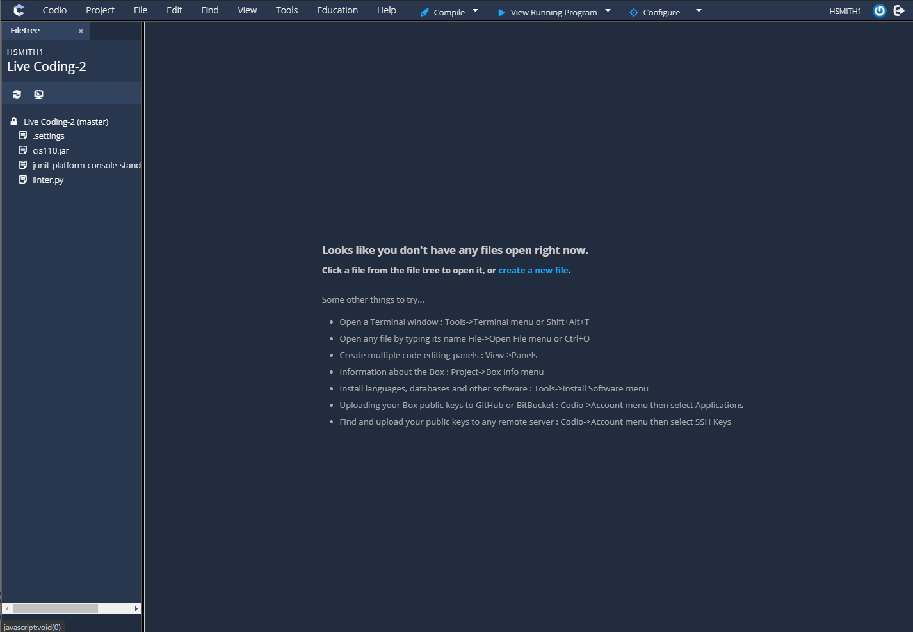
When you first open a project:
The filetree
All files you use will live here.
You can click on them to show them in the editor.

Slide 34
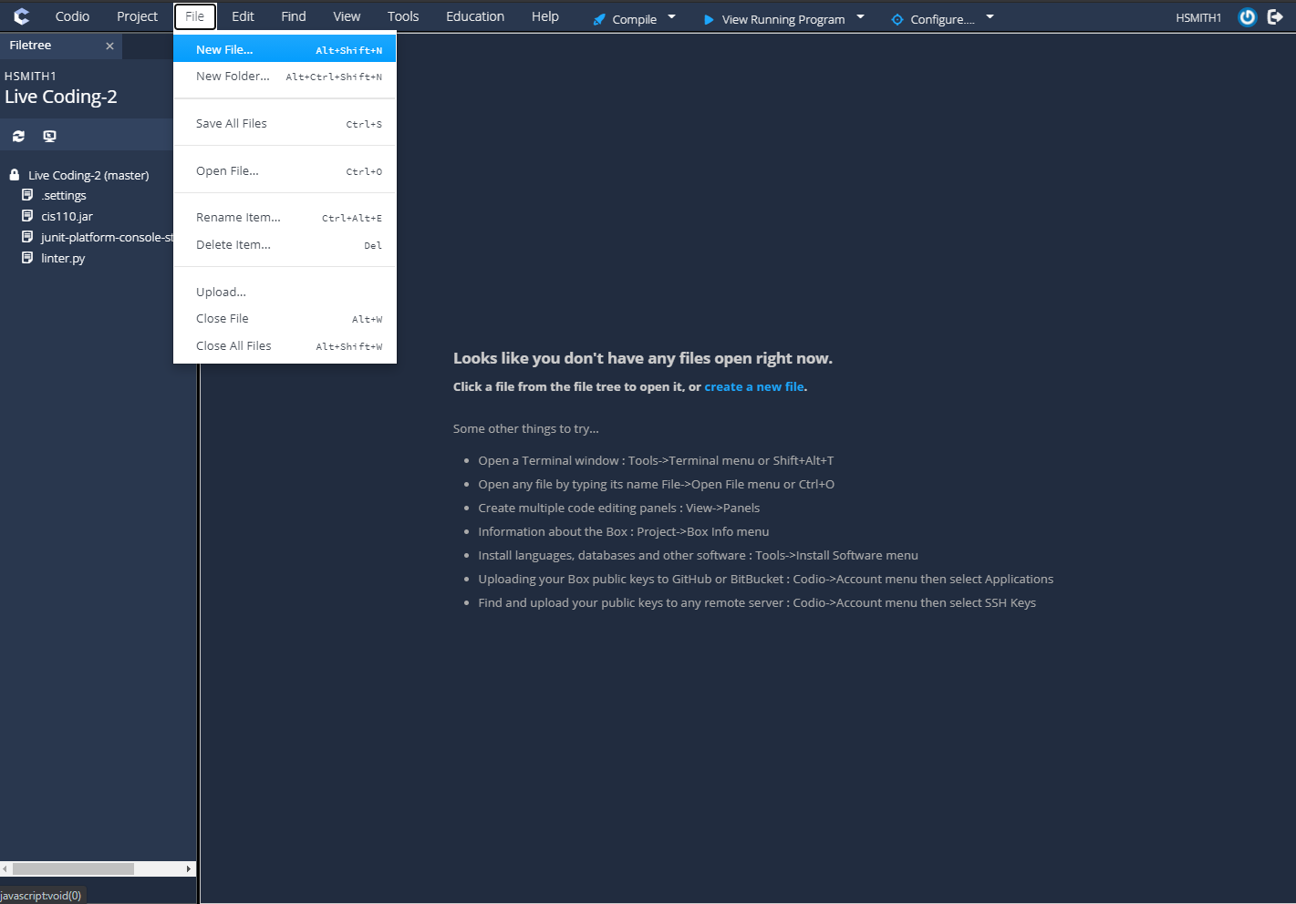

Slide 35
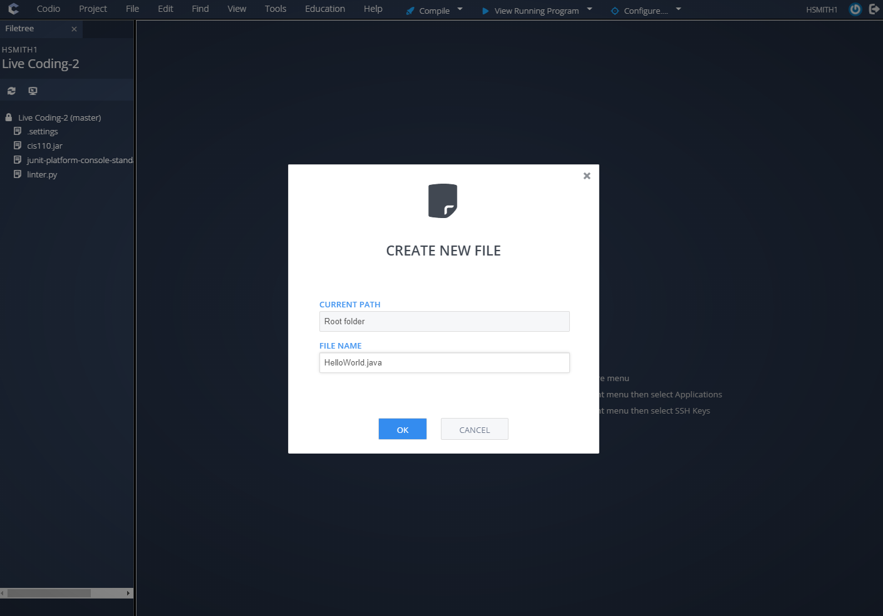

Slide 36
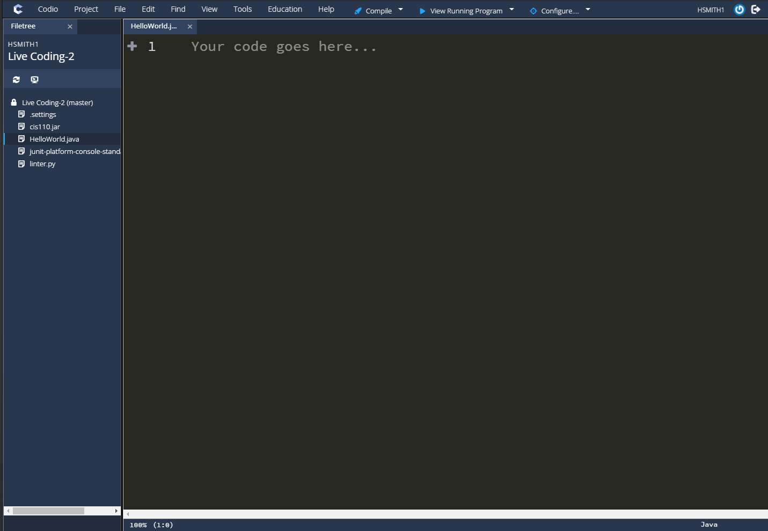
The new file appears in the filetree!
The editor
HelloWorld.java (an empty file) is now open in the editor for editing!

Slide 37
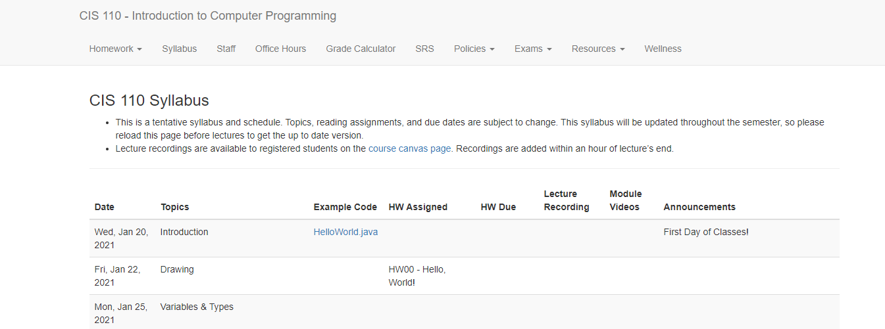
This is the Syllabus page of the website

Slide 38
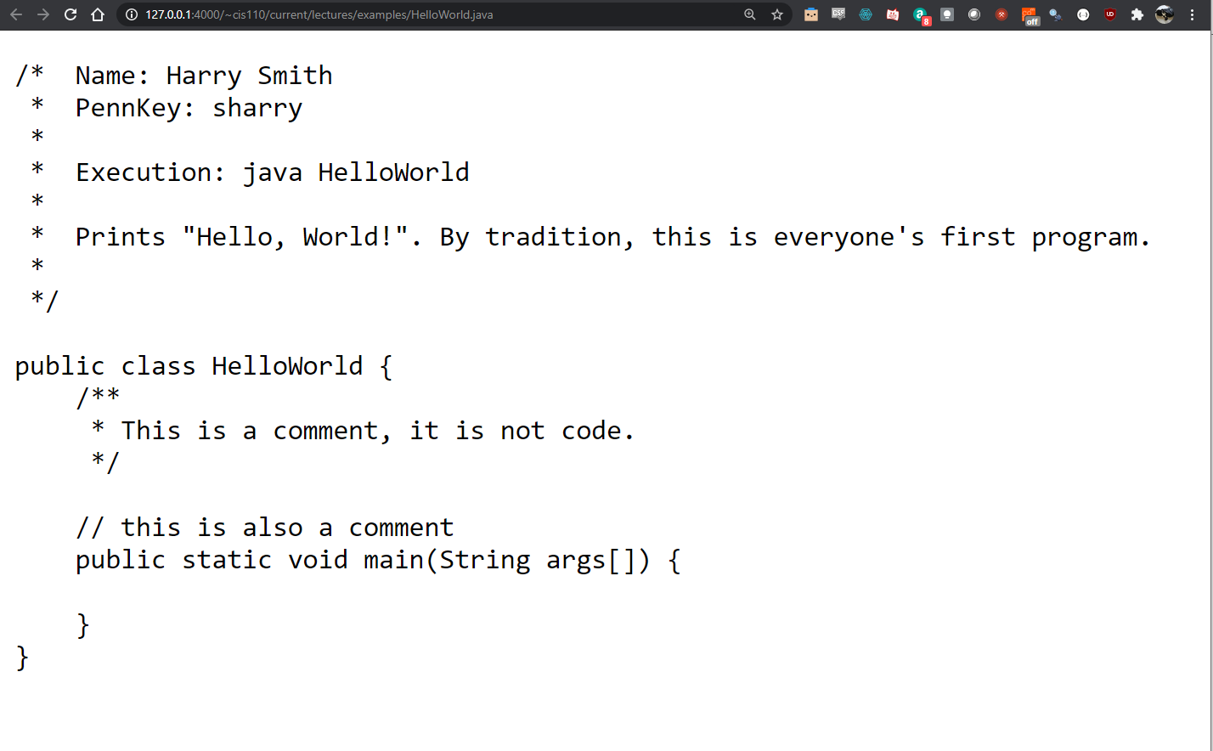
Highlight everything, and then COPY it…

Slide 39
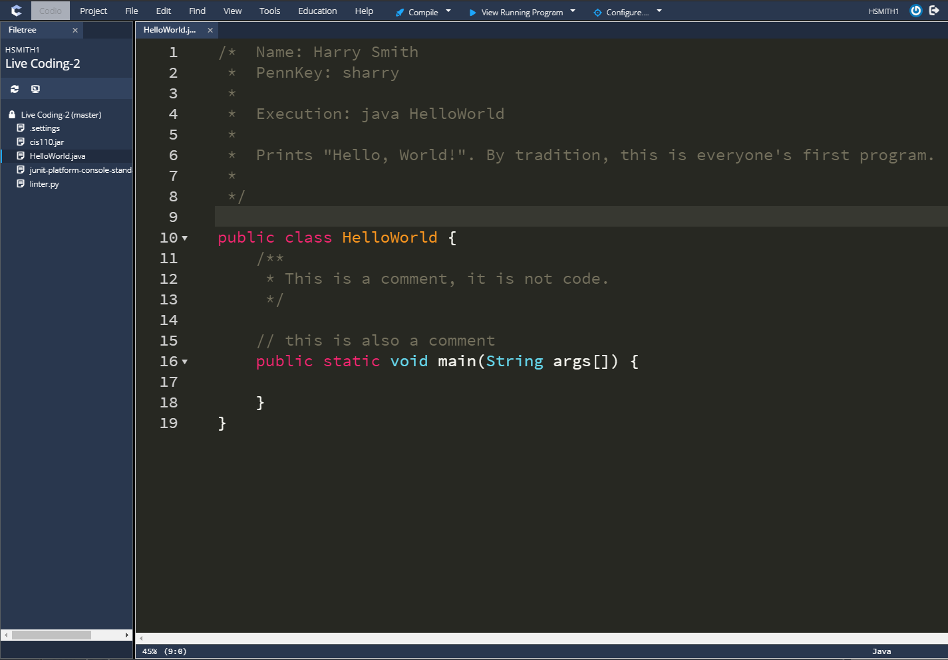
..and PASTE IT into here!

Slide 40
Our First Program

Slide 41
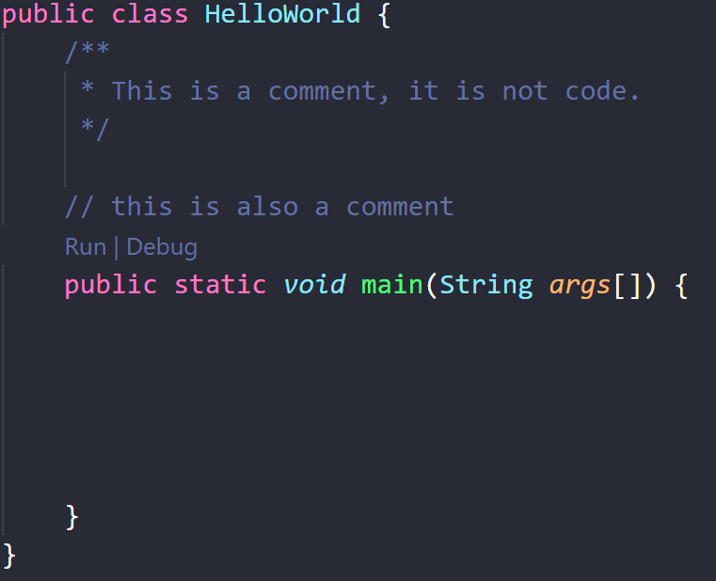

Code goes here!

Slide 42
Class Name
(must match the filename)
Code goes here!

Slide 43
Class Name
(must match the filename)
Comments
(notes, not run as code!)
Code goes here!

Slide 44
Class Name
(must match the filename)
Comments
(notes, not run as code!)
Code goes here!
This is called “the body of our main method.”

Slide 45
Compile button
Click this button to compile all .java files in your filetree.
View Running Program Button
Shows you the visual output of your program.
The filetree
All files you use will live here.
You can click on them to show them in the editor.

Slide 46
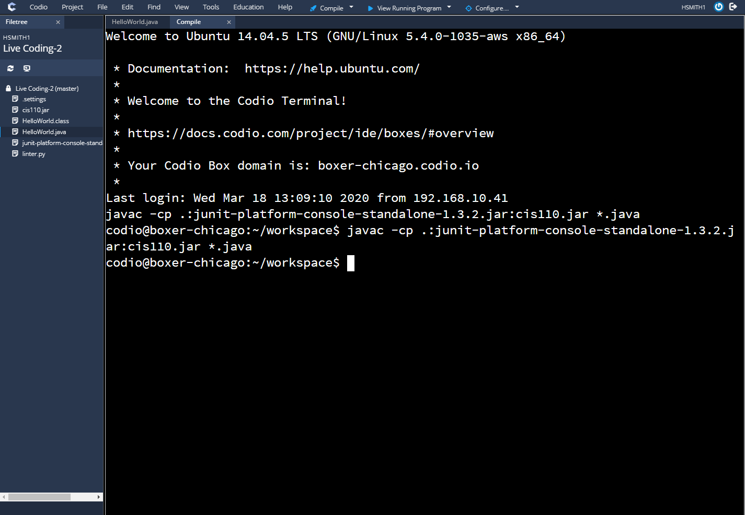
After clicking the Compile button…
The Terminal
This is space where we can write individual commands to communicate with the computer.

Slide 47
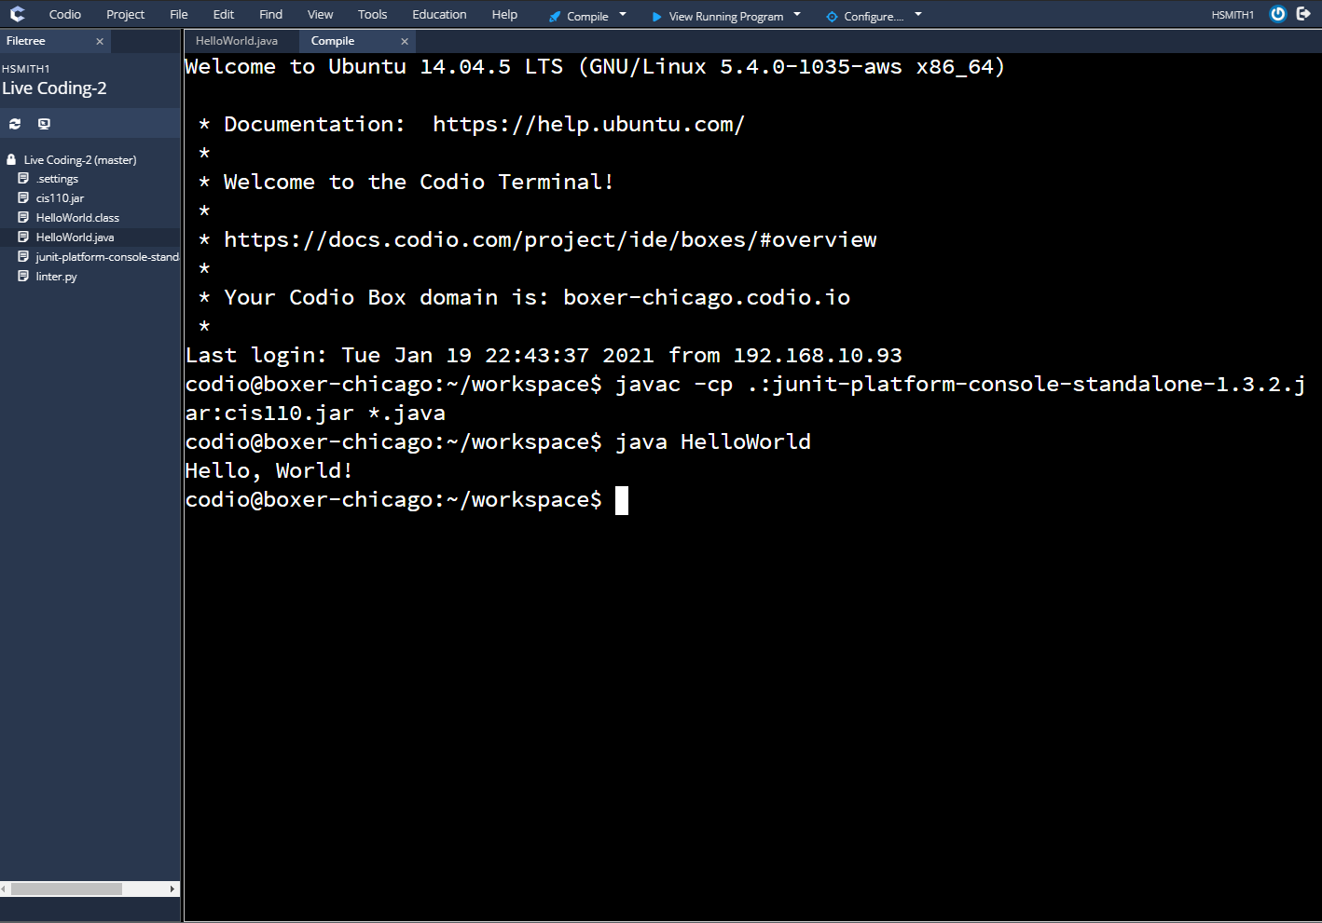
Running our program
We typed “java” followed by our program’s name (“HelloWorld”). Then we hit enter.
The Output
Whatever we asked our program to print will appear on the following line(s). In this case, our program prints “Hello, World!”

